Slide 1
FAST TRACK:
A New Era of Efficiency in proposal evaluations
U.S. Army contracting command
Detroit arsenal
Mr. Charlie Gram, Contracting Director Intelligence, Operations and Sustainment Support
Mr. Tom Phillips, Chief, Pricing Division
13 August 2026

Slide 2


Slide 3



What is Fast Track?
An AI-Enabled Acquisition Support Platform
The Core Mission:
FAST TRACK is a modular, internally developed Army platform designed to accelerate the competitive evaluation of vendor proposals. It acts as an intelligent force multiplier, automating tedious document cross-referencing so acquisition teams can focus on critical analysis and decision-making.

Slide 4
Scaling Adoption and Operational Capabilities
OPERATIONAL SCALE & DoD-WIDE ADOPTION
From Pilot to Enterprise: Began as an initial Army pilot, rapidly scaled to all the Army, and is now being piloted or implemented across much of the DoD.
Service & Hardware Scope: Successfully transitioned from foundational service contracts to complex hardware acquisitions.
Comprehensive Coverage: Now utilized across multiple proposal volumes, including Technical, Past Performance, LPTA, and Pricing.
HOW IT EVALUATES: Draft Analysis vs. Final Judgment
System-Generated Draft Analysis: Fast Track ingests solicitation requirements from Sections L, M, and C and cross-references them against the proposal to automatically generate a draft SWOO (Strengths, Weaknesses, Opportunities, Observations) analysis.
Human-in-the-Loop (The Evaluator's Role): The draft SWOO is a starting point, not the final decision. Human evaluators are required to validate the system-generated analysis, apply expert judgment, conduct the official compliance review, and make the final source selection decision.

Slide 5
Rigorous SME Verification
An Analytical Accelerator: The platform acts exclusively as an analytical accelerator. It enhances evaluation speed and accuracy but never assumes the legal or professional duties of a contracting officer.
Sovereign Human Control: Ultimate responsibility for ratings, risk, and best-value selections remains strictly with human evaluators. Fast Track cannot make, submit, or authorize any final procurement decisions.
Fact-by-Fact Analysis: Every single observation, citation, and finding proposed by the AI is treated strictly as an unverified draft. Subject Matter Experts independently cross-examine each claim against the source files.
The SME Standard: No data point is incorporated into the official record without an expert evaluator verifying its absolute accuracy, eliminating any possibility of unvetted AI influence.
Double-Pass Human Review: Every draft observation from the AI must be vetted by a primary evaluator and approved by a technical lead before finalization.

Slide 6
Safeguarding Your Intellectual Property
ENGINEERED BY THE ARMY TO MEET THE HIGHEST STANDARDS OF TRUST, COMPLIANCE, AND DATA SECURITY.
Security Pillar | How It Protects Your Proposal Data
100% In-House & IL5/IL6 Secure | Built entirely by the Army to operate on secure unclassified (IL5) and classified (IL6) clouds. No commercial software companies have access to the code or your data.
Ephemeral Processing | Proposal files are processed temporarily in active session memory. They are never permanently stored on servers and are completely purged when the evaluation session ends.
Absolute Confidentiality | Your proprietary solutions remain strictly confidential. The system operates under strict access controls, ensuring your technical methodologies and pricing models are never exposed, shared, or leaked.
Strict Data Isolation | The AI operates in completely isolated silos. The Government team evaluating your proposal only sees your data, ensuring zero cross-pollination with competitors.
Retrieval-Augmented Generation (RAG) | Rather than relying on generic AI knowledge bases, our platform uses RAG. The AI is strictly bound to retrieve answers directly from the provided solicitation and proposal PDFs.

Slide 7
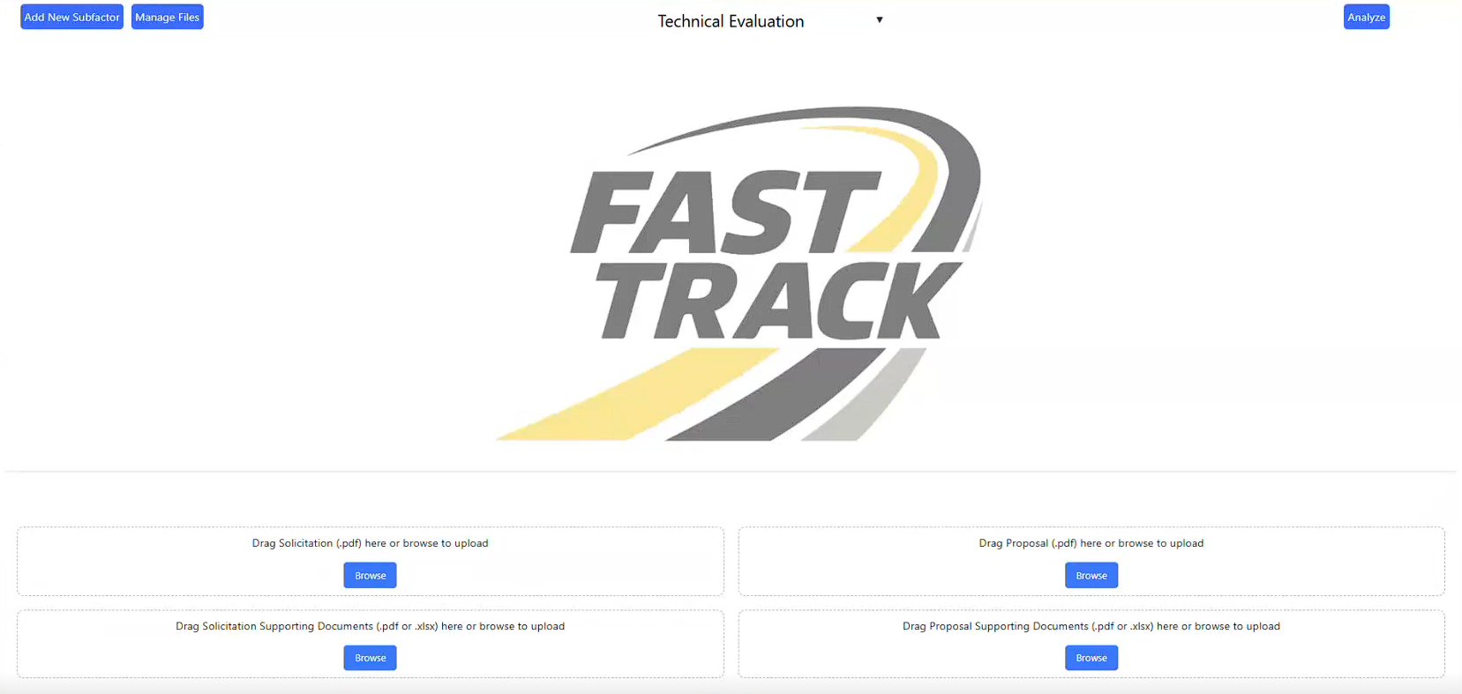

DISTRIBUTION STATEMENT A: Approved for Public Release
DISTRIBUTION STATEMENT A. Approved for Public Release.

Slide 8
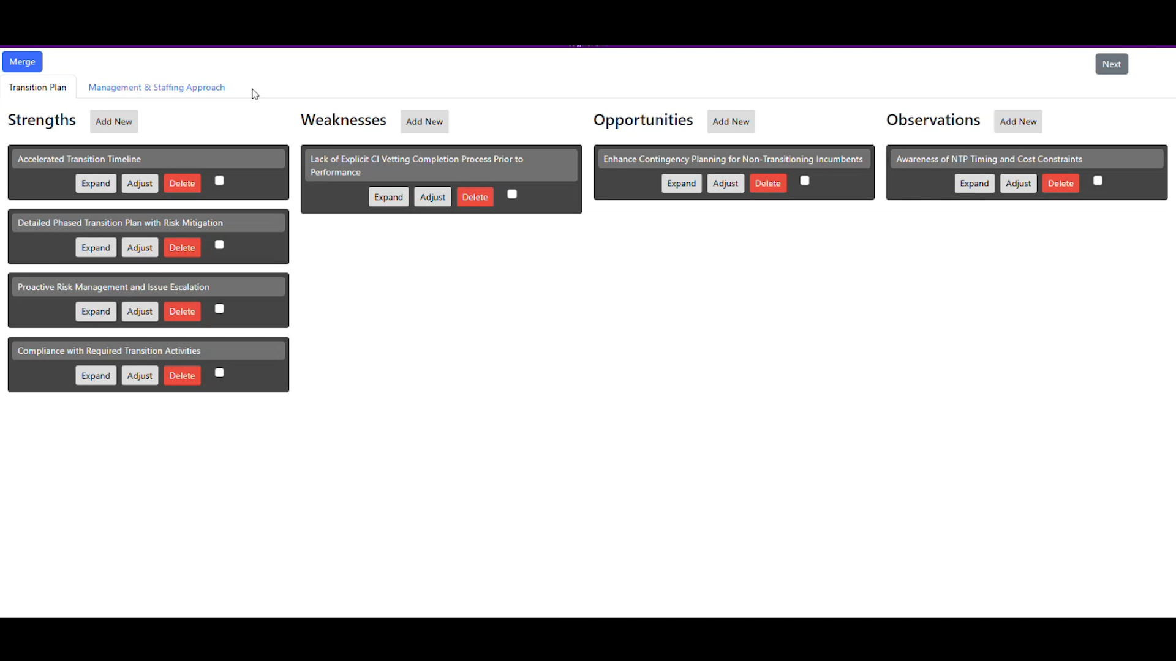
DISTRIBUTION STATEMENT A: Approved for Public Release
DISTRIBUTION STATEMENT A. Approved for Public Release.
Notes:
Toggle two tabs

Slide 9
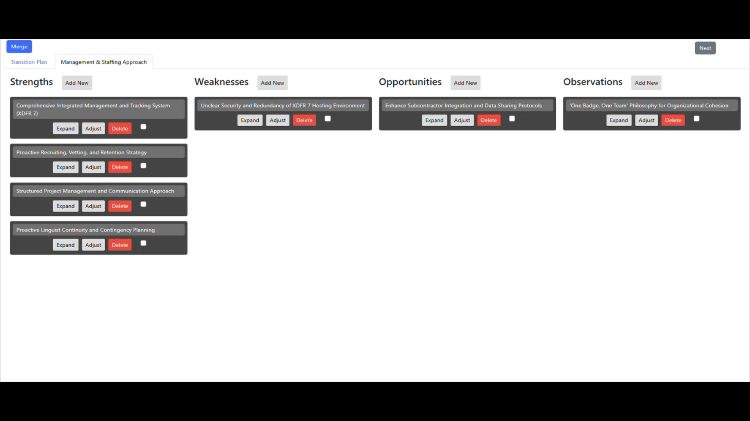
DISTRIBUTION STATEMENT A: Approved for Public Release
DISTRIBUTION STATEMENT A. Approved for Public Release.
Notes:
SWOO

Slide 10
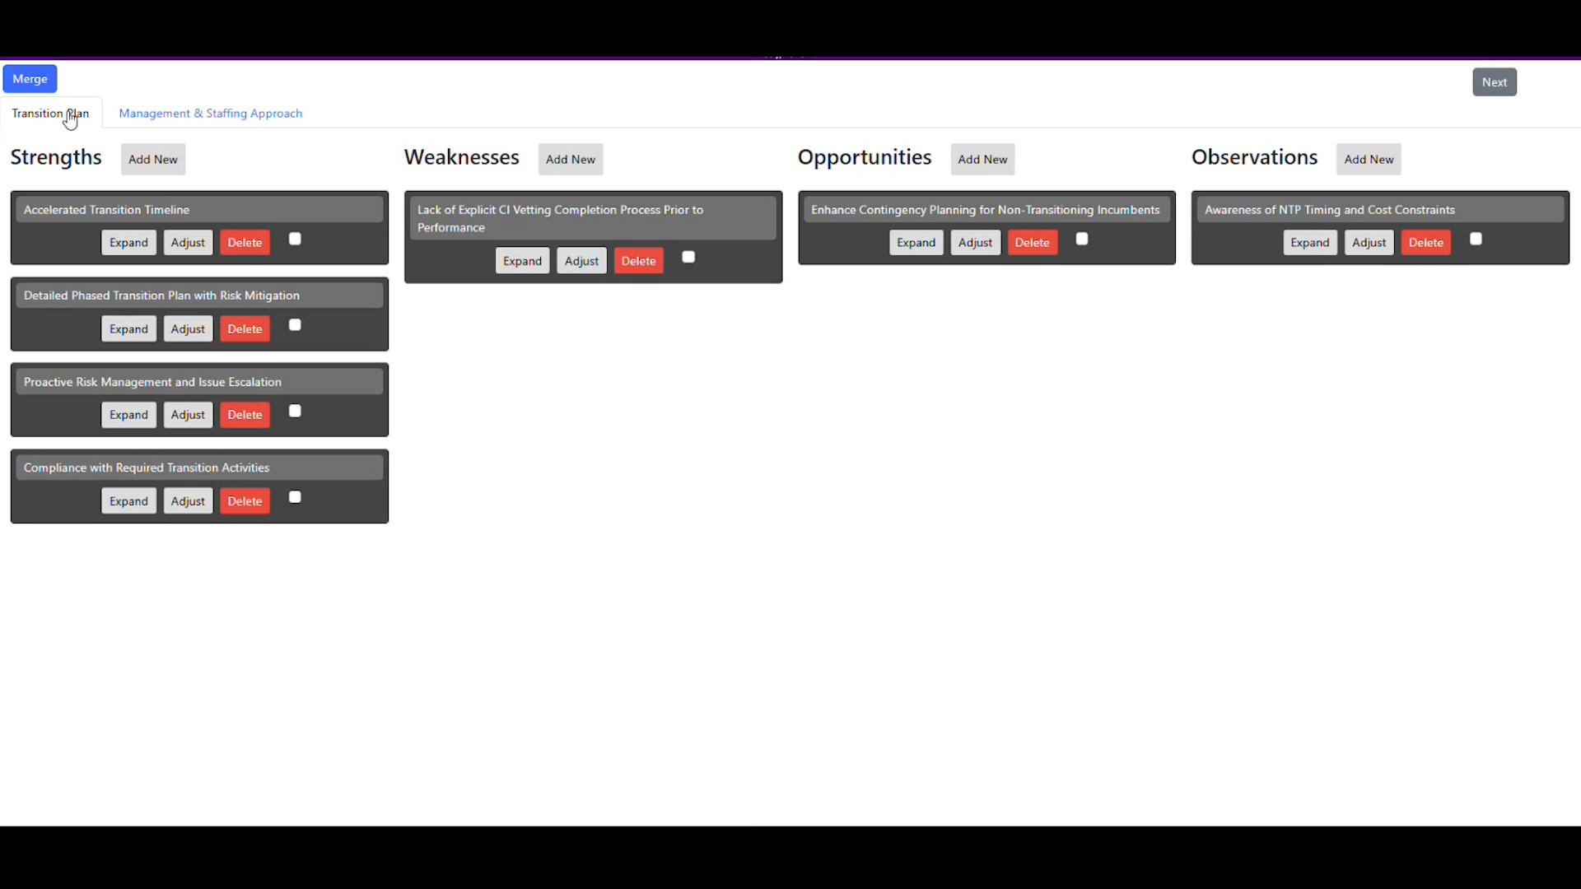
DISTRIBUTION STATEMENT A: Approved for Public Release
DISTRIBUTION STATEMENT A. Approved for Public Release.
Notes:
Review each section before moving on

Slide 11
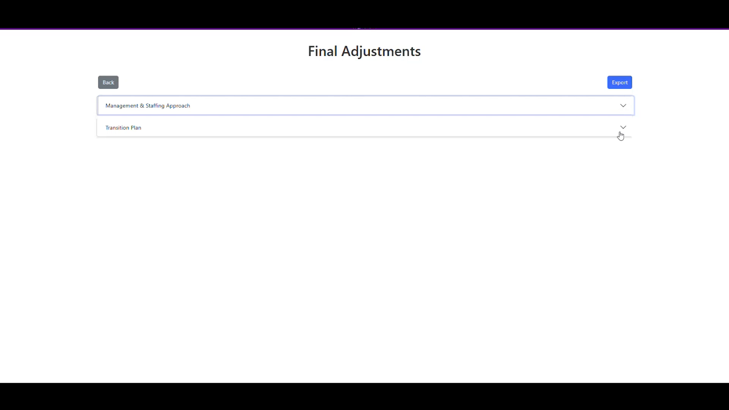
DISTRIBUTION STATEMENT A: Approved for Public Release
DISTRIBUTION STATEMENT A. Approved for Public Release.
Notes:
Final Adjustments

Slide 12
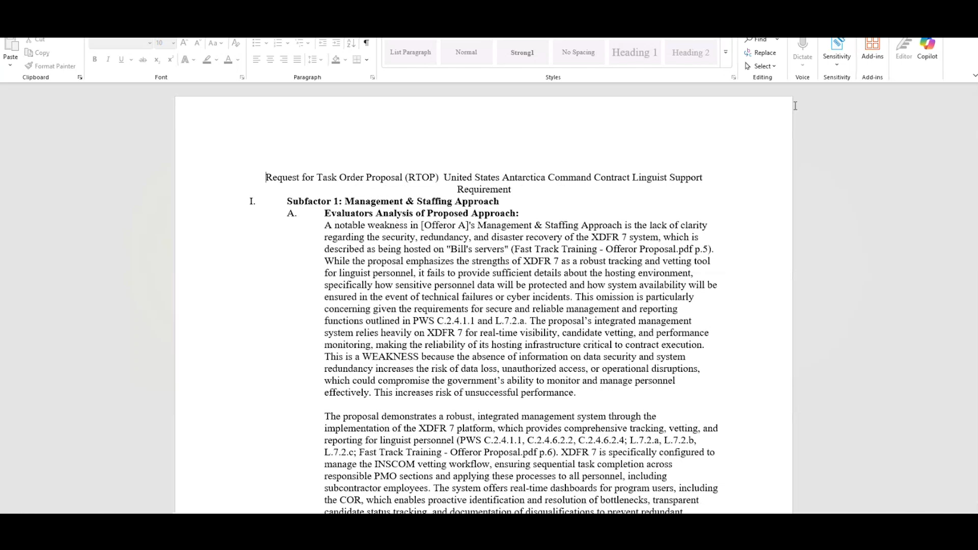
DISTRIBUTION STATEMENT A: Approved for Public Release
DISTRIBUTION STATEMENT A. Approved for Public Release.
Notes:
Word doc scrolling

Slide 13
A Faster, Fairer, and More Thorough Procurement
How integrating FAST TRACK benefits the defense industrial base.
SIGNIFICANTLY FASTER AWARD TIMELINES (73%-75%)
Slashes the administrative lead time required to read and cross-reference thousands of pages.
Your Benefit: Contracts are awarded sooner, allowing you to kick off operations and recognize revenue without months of prolonged limbo.
DEEPER FOCUS ON YOUR INNOVATION
Evaluators are no longer fatigued by manually hunting for compliance checkboxes.
Your Benefit: Human experts have the time and mental energy to deeply analyze the unique, innovative aspects of your technical solution.
ENHANCED PROPOSAL SAFEGUARDS
The AI acts as an automated safety net, ensuring every claim in your proposal is mapped directly to the evaluation criteria.
Your Benefit: High-quality proposals are protected from being derailed by an evaluator accidentally missing a critical detail buried deep in the text.

Slide 14
Fast Track: Proposal Best Practices
1. Direct PWS Traceability:
  Explicit Mapping: Map all examples and proof points directly back to the PWS (Section C) and the specific evaluation factors/subfactors in the solicitation.
  Substance: Do not simply parrot requirements. You must provide substantive details (the "how").
2. Clean Data & Formatting:
  Excel Best Practices: Use single header rows. Avoid merged cells or nested headers.
  No Hidden Text: Ensure all text is fully visible. Do not use white text or hidden fonts.
3. Contextualizing Graphics:
  Describe Your Data: Do not rely solely on images to convey value.
  Clear Captions: Include a clear, text-based summary adjacent to every chart or graph.

